Slide 1
Module 3: Security
Intrusion Detection Systems
ML for Cybersecurity
Fall 2020

Slide 2
Learning Objective

Slide 3
Learning Objectives
Learn about the difference between signature-based and anomaly-based detection
Learn about different types of intrusion detection systems
Learn about different modern intrusion detection systems (Zeek, Snort, etc.) and how they can be applied to attack detection.

Slide 4
INTRUSION DETECTION

Slide 5
Intrusion Detection
“Burglar alarms for the network.”
Idea: make systems sensitive to threatening actions, and make them capable of alerting authorities when they notice anomalies
Necessarily post-hoc
Broad types
Statistical analyzers (anomaly based)
Rules-based systems, Attack-signature detectors (misuse)
Others

Slide 6
Know Your Attacker
Most attackers run scripts to probe for vulnerabilities, then return later to exploit them
Probes tend to come in waves as new holes are discovered
Probes look very different than typical network use
Actual attack may come long after probe

Slide 7
Types of Intrusion Detection
Signature-Based
define “what is abnormal” using attack signatures
traffic that matches an attack signature as attack traffic
Anomaly-Based
define “what is normal” using profiles
traffic that does not match the profile as abnormal

Slide 8
Simple IDS
v=listen(frequently-exploited-unused-port);
while(1) {
s=accept(v, who, howbig);
notify_the_authorities(s, who, howbig);
close(s);
}
This won’t catch stealth scanners
Doesn’t have a global view
Can’t detect attacks on systems in use
Surprisingly effective at catching scans nonetheless

Slide 9
Statistical Analysis
Constantly capture packets, watch logs, note typical flows
“95% of traffic flows from inside the firewall to outside web services”
Trigger alarms when traffic not matching typical flows is seen
Can be a first alert against configuration problems
Tends to rely on a more global view

Slide 10
Rule-based Systems
Monitor logs and network for behavior violating or matching static rules
Require some knowledge of attack behaviors
Less prone to false alarms
Often combined with anomaly detectors

Slide 11
Using an IDS
Plan your incident response process well before you install the system
Know what you’re looking for
Make the system comprehensive
Don’t overreact to alarms
If using a rules-based system, keep up with vulnerability reports

Slide 12
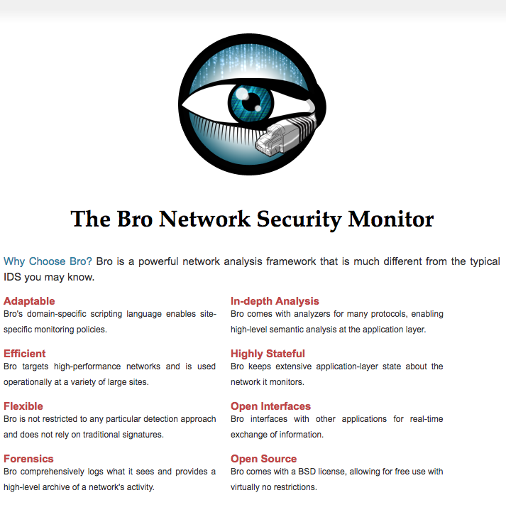

Slide 13
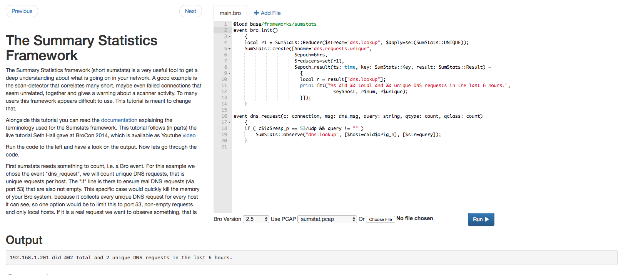
Notes:
http://try.bro.org/

Slide 14
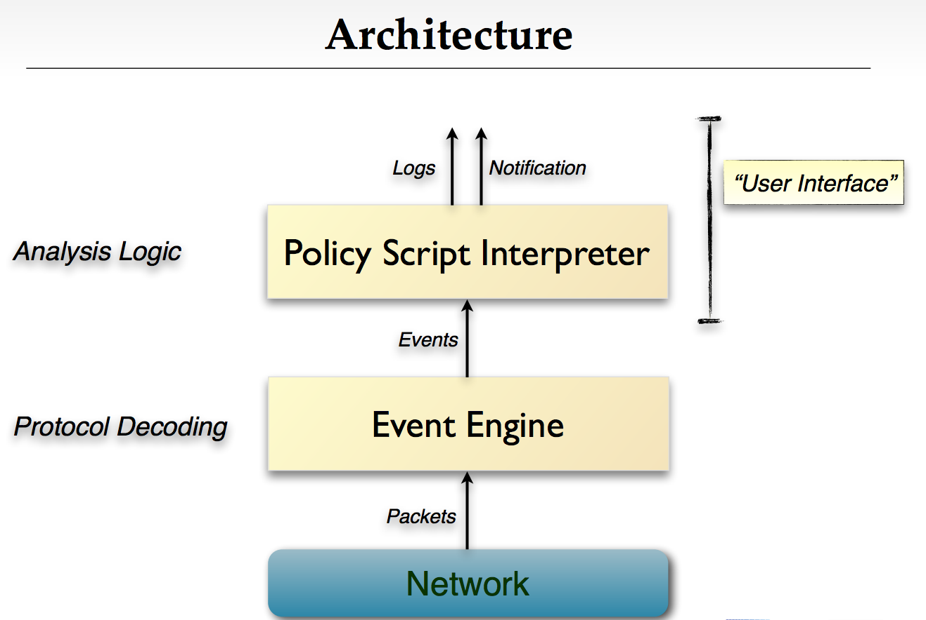

Slide 15
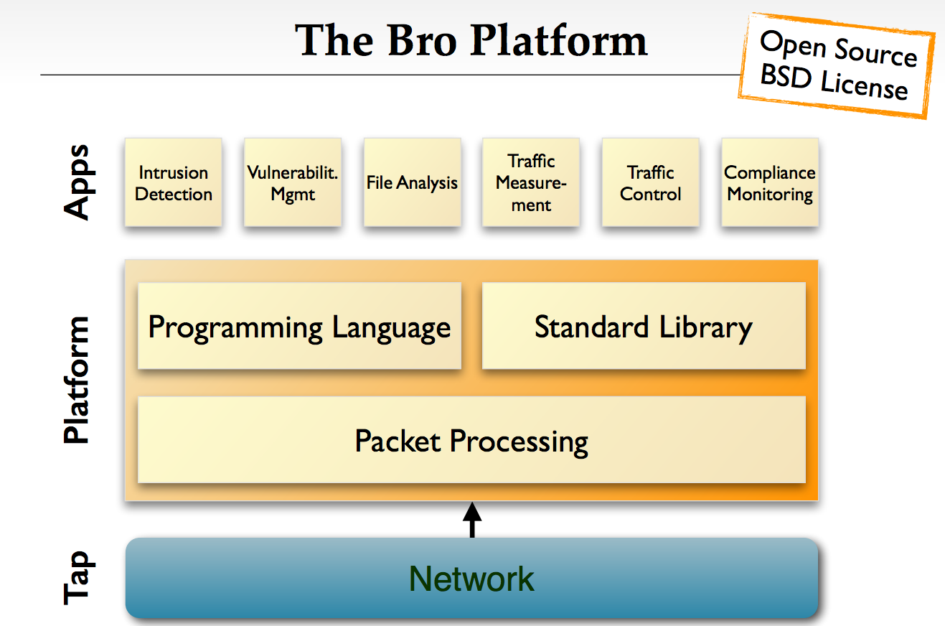

Slide 16
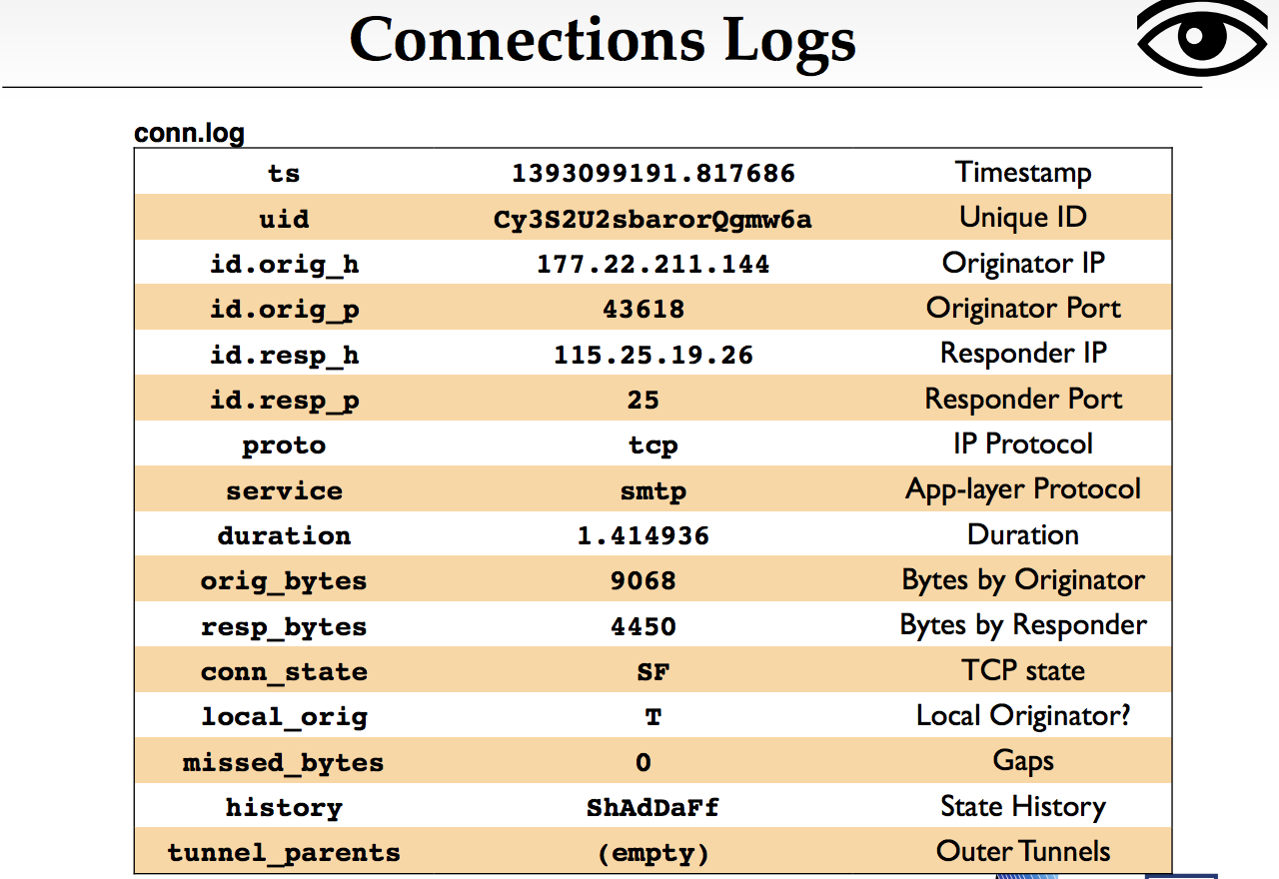

Slide 17
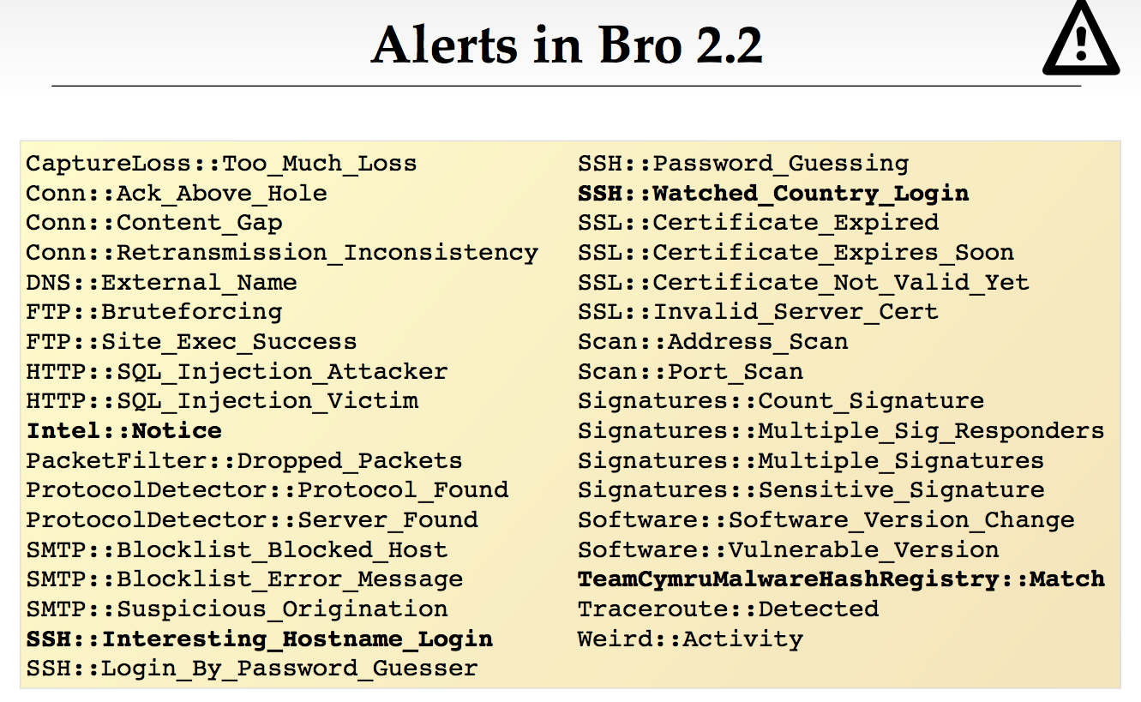

Slide 18
Demonstration: Zeek

